Slide 1

Welcome to Crash course of Microsoft Azure

Slide 2
Lesson 2: Introduction to Machine Learning
Arthur Samuel introduces machine learning in his paper as a subfield of computer science that gives computers the ability to learn without being explicitly programmed.
Machine learning is a data science technique used to extract patterns from data, allowing computers to identify related data, and forecast future outcomes, behaviours, and trends.

Slide 3
In short ML:
Extract patterns from Data
Identify related data
Forecast future outcomes, behaviours and trends

Slide 4
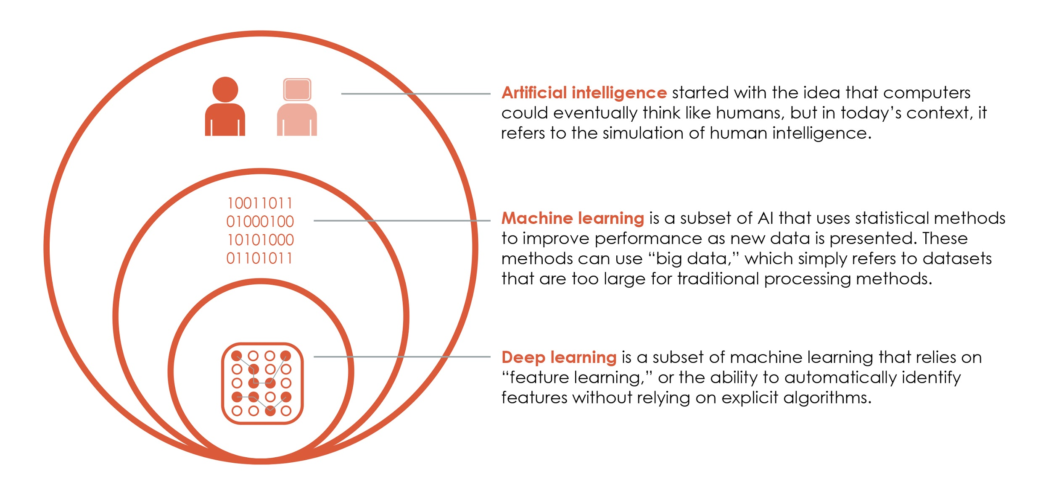

Slide 5
We can see that Traditional Programming consists of only two steps:
Command > Action.
Machine learning entails a three-step process: Data > Model > Action.

Slide 6
Traditional Programming:
Takes Rules and data as an input to deliver answer can be used in transactional system ,in library management etc.
Machine learning :
It takes answers and data as input to deliver rules as an output can be used in fraud detection system ,in anomaly detection etc.

Slide 7
If you want to create a function that multiplies two numbers then Traditional Programming is Best Approach.
You have some images that contain handwritten numbers. You want to create a program that will recognize which number is in each picture, but you're not sure exactly what characteristics can be used to best tell the numbers apart. ML will be used here.

Slide 8
History Of ML
1950’s - AI came up where the main motive was building programs that was copying the way humans think and act.
1980’s - Focus shifted towards specific areas of AI. One of the area is ML, which is writing programs to identify patterns without explicitly being, programmed to do so. Neural nets were, inspired by the structure of human brains.
2010’s - Power of computers got neural nets back into spotlight. Large neural nets with many hidden layers and hidden nodes. Examples are Language processing and Image classification. That is how the term Deep Learning came into picture.

Slide 9
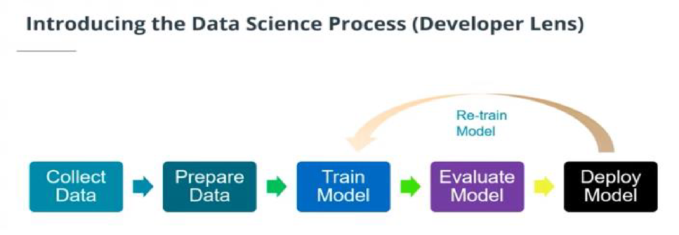

Slide 10
Techniques In ML:
Statistical machine learning
Deep Learning
Reinforcement Learning
Data Types:
Numerical Data – Integers or Floats
Time Series Data – Numerical data over equally spaced time
Categorical Data
Text Data – Words or Sentences
Image Data – Picture or Snapshot of video

Slide 11
Numeric data can be scaled or transformed to fit some range. The two common approaches to scale data are standardization and normalization.
Standardization : Scale the data to have a mean of 0 and a standard deviation of 1
The Formula to apply on every value(x) is
(X-Mean)/Deviation
2. Normalization : Scale the data to fit the range of [0,1]
The Formula to apply on every value(x) is (X-Xmin)/(Xmax-Xmin)

Slide 12
Categorical data needs to be represented as numerical data.
First Approach:
Ordinal encoding :convert the categorical data into integer codes ranging from 0 to (number of categories – 1)
Drawback:
A simple approach which implicitly assume that there is an order between the categorical value which can lead some times to false analysis.

Slide 13
Second Approach:
One hot encoding : were each categorical value is transformed to a column (if a column has n categorical value she will be transformed to n column
Drawback:
A problem of one-hot encoding is that it can potentially generate a very large number of columns

Slide 14
Image Data:
Image data : the data need to be represented as numerical
To encode an image we need to know the position (horizontal ,Vertical) and the colour of each pixel
Greyscale and RGB:
In grayscale images: each pixel can be represented by a single number, which typically ranges from 0 to 255 (1 depth)
In coloured images: each pixel can be represented by a vector of three numbers (each ranging from 0 to 255) for the three primary colour channels: red, green, and blue. These three (RGB) values are used together to decide the colour of that pixel.

Slide 15
Text Data:
Text data : the data need to be processed ( to be represented in the last step as numerical)
1.Normalization
One of the challenges that can come up in text analysis is, there are often multiple forms that mean the same thing.
Lemmatization is an example of normalization. A lemma is the dictionary form of a word and lemmatization is the process of reducing multiple inflections to that single dictionary form
Tokenized the text (i.e., split each string of text into a list of smaller parts or tokens), removed stop words (the), and standardized spelling process of reducing multiple inflections to that single dictionary form.
A vector is simply an array of numbers—so there are many different ways that we can vectorize a word or a sentence, depending on how we want to use it.

Slide 16
Perspectives In ML:
The general idea of machine learning is that we create a model and then feed data to it to generate output (such as prediction )
Computer science :
Perspective : Describe ML as the process where we used input features to create program that can generate output
Output=Program (input)
Data is represented in a table . Where Rows can be called entities , observation or instance and Columns can be called properties or features.

Slide 17
Statistical :
Perspective : Describe ML as mathematical function that based on independent variable can generate the value of dependent variable
Dependent Variable = f(Independent Variables)
Dependent Variable is a variable that depend to one or multiple variables.

Slide 18
ML Ecosystem:
Libraries
Development Environments
Cloud Services
Notebooks
End-to-end with Azure

Slide 19
Model vs Algorithm
Models are the specific representations learned from data
Algorithms are the processes of learning
We can think of the algorithm as a function—we give the algorithm data and it produces a model:
Model = Algorithm (Data)

Slide 20
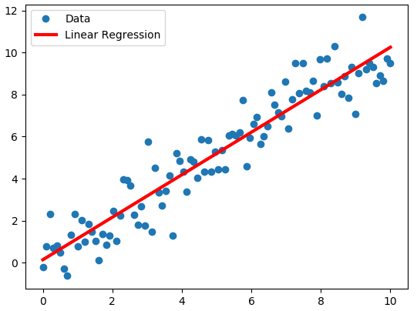
Linear Regression
As the term suggests, linear regression is an algorithm that uses a straight line (or plane) to describe relationships between variables
y = mx+b
Where m is, called the slope of the line, and b is the y-intercept. Again, this is the general equation.

Slide 21
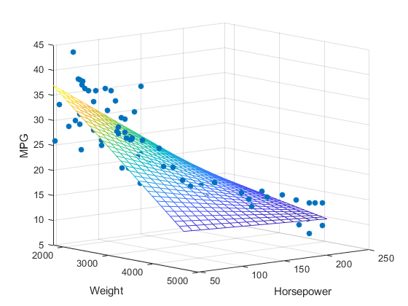
Multiple Linear Regression
In more complex, cases where there is more than one input variable, we might see something like this:
In this case, we are using multiple input variables to predict the output. When we have multiple input variables like this, we call it multiple linear regression.

Slide 22
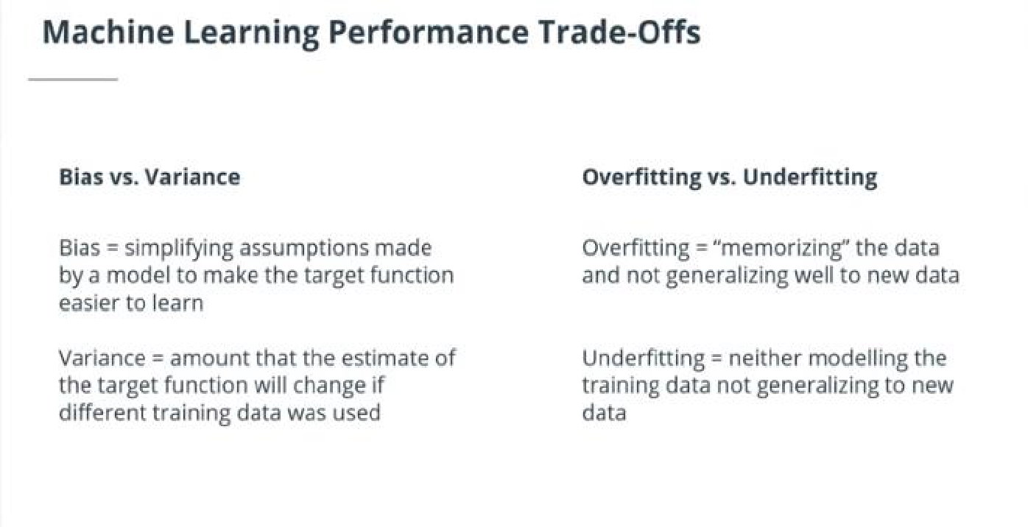

Slide 23
Parametric ML Algorithm
Parametric machine learning algorithms make assumptions about the mapping function and have a fixed number of parameters.
No matter how much data is, used to learn the model, this will not change how many parameters the algorithm has. With a parametric algorithm, we are selecting the form of the function and then learning its coefficients using the training data.

Slide 24
Benefits:
Simpler and easier to understand; easier to interpret the results
Faster when talking about learning from data
Less training data required to learn the mapping function, working well even if the fit to data is not perfect
Limitations:
Highly constrained to the specified form of the simplified function
Limited complexity of the problems they are suitable for
Poor fit in practice, unlikely to match the underlying mapping function.

Slide 25
Non- Parametric ML Algorithm
Non-parametric algorithms do not make assumptions regarding the form of the mapping function between input data and output. Consequently, they are free to learn any functional form from the training data.
A simple example is the K-nearest neighbours (KNN) algorithm

Slide 26
Benefits:
High flexibility, in the sense that they are capable of fitting a large number of functional forms
Power by making weak or no assumptions on the underlying function
High performance in the prediction models that are produced
Limitations:
More training data is required to estimate the mapping function
Slower to train, generally having far more parameters to train
Overfitting the training data is a risk; overfitting makes it harder to explain the resulting predictions

Slide 27
Lesson 4: Supervised And Unsupervised Learning

Slide 28
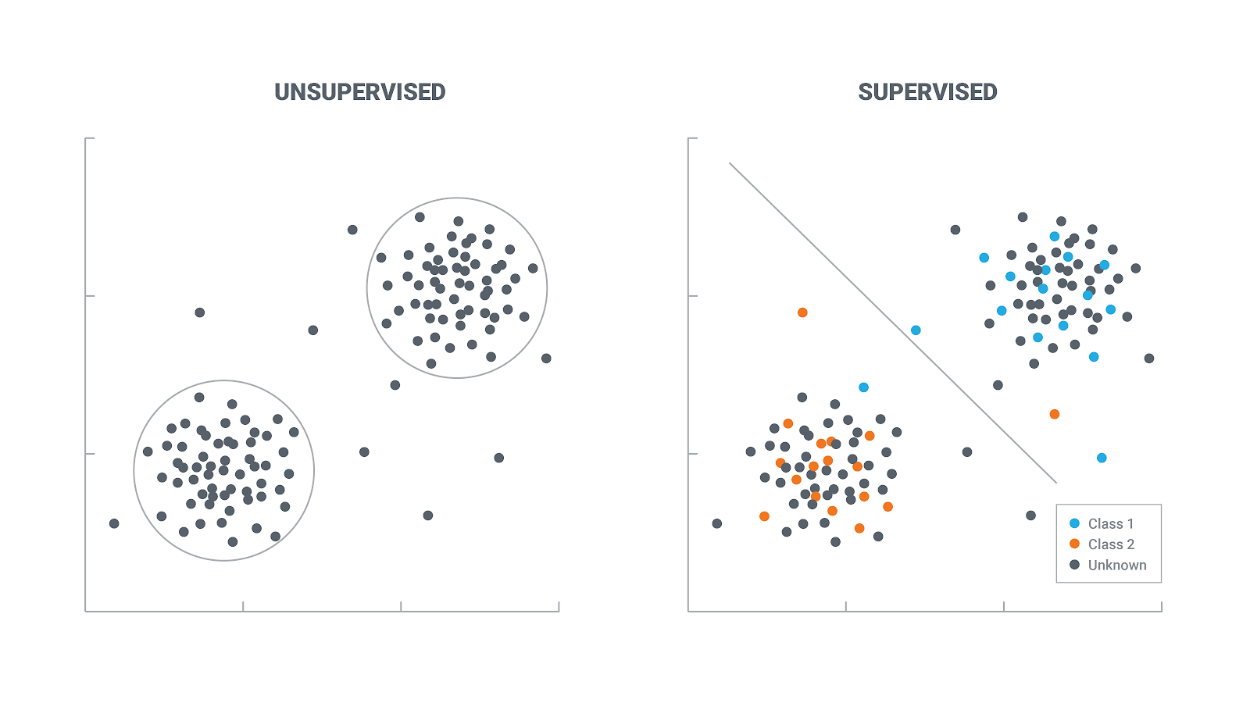
Supervised & Unsupervised Learning:
Supervised- Learns from data, that contains both the inputs and expected outputs (e.g., labelled data).
Unsupervised -Learns from input data only; finds hidden structure in input data.

Slide 29

Reinforcement Learning:
Learns how an agent should take action in an environment in order to maximize a reward function.

Slide 30
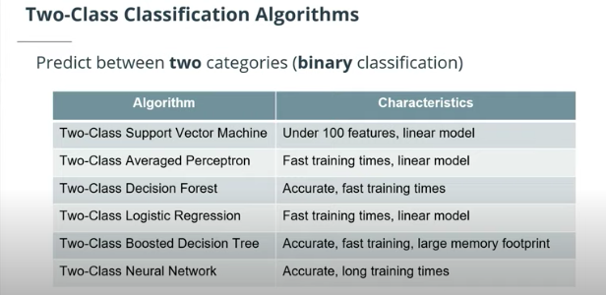

Slide 31
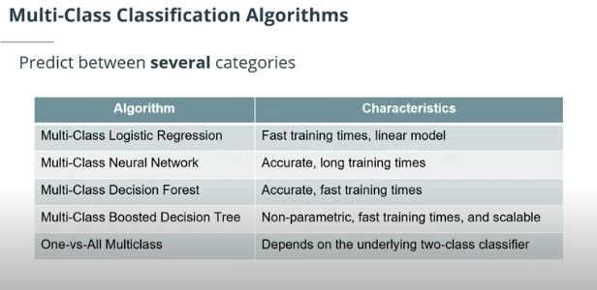

Slide 32
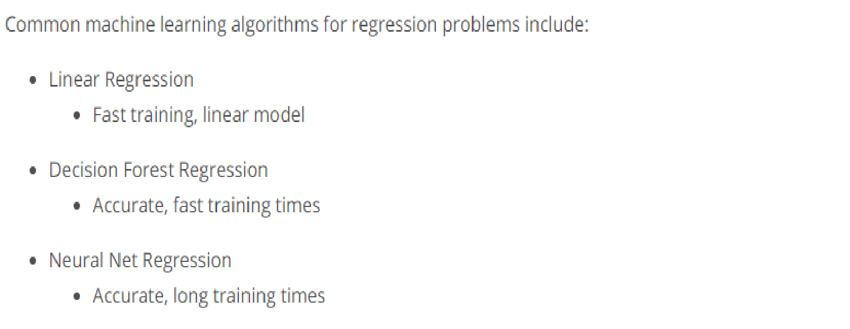
Categories of Algorithms

Slide 33
1. Linear Regression
Approaches:
Ordinary Least square method – Computes error as the sum of squares of distance from the actual value to the predicted line. It fits the model by minimizing the squared error. Assumes strong linear relationship between the inputs and the dependent variables.
Gradient descent – Approach is to minimize the amount of error at each step of the model training process.

Slide 34
2.Decision Forest Regression:
Resampling method – This controls the method used to create the individual trees.
Number of decision trees – Maximum number of decision trees that can be, created in the ensemble.
Maximum depth of the decision trees – Number to limit the depth of any decision tree.
Number of random splits per node – Number of splits to use while building each node of the tree.
Minimum number of samples per leaf node – Minimum number of cases that are required to create any terminal node in a tree.

Slide 35
3.Neural Network Regression:
Number of Hidden Nodes – Helps in customizing the number of hidden nodes and the neural network
Learning Rate – This controls the size of the step taken at each iteration before correction.
Number of Learning Iterations – The maximum number of times the algorithm should process the training cases.
.

Slide 36
Clustering?
Clustering is the problem of organizing entities from the input data into a finite number of subsets or clusters

Slide 37
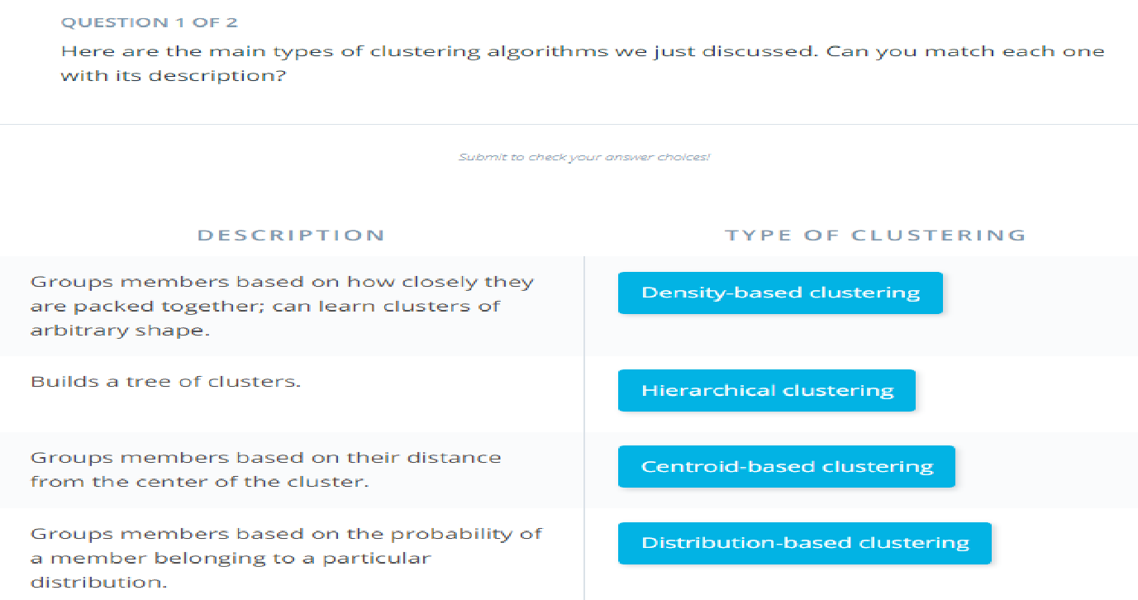

Slide 38
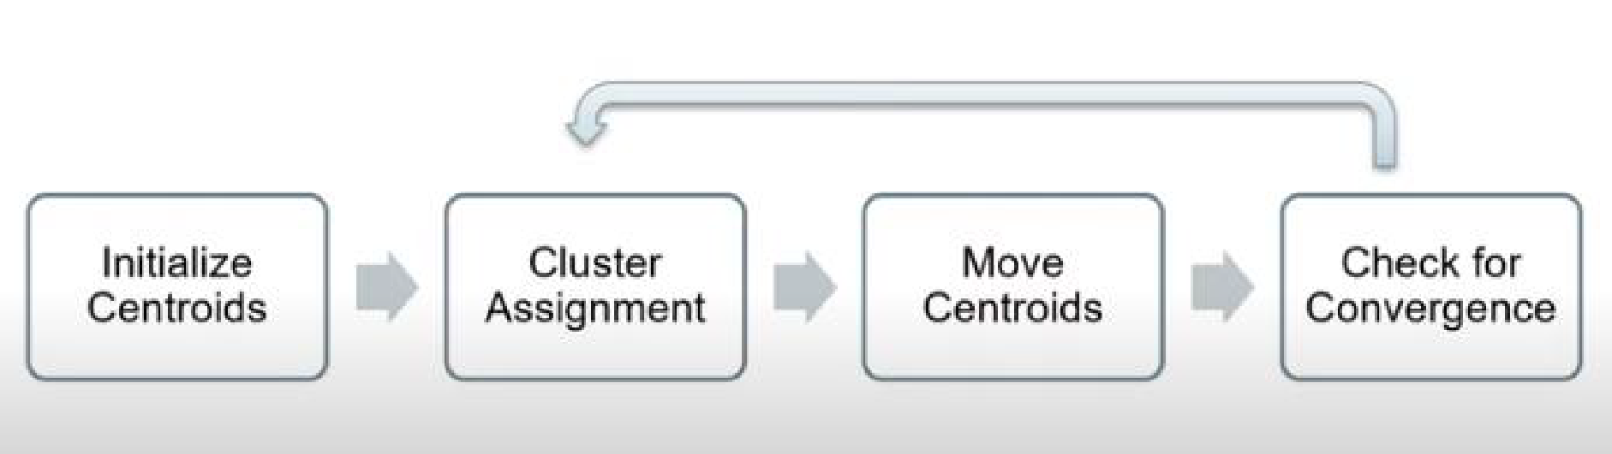
K-Means Clustering?
K Means Clustering – This is a centroid based unsupervised clustering algorithm.
It creates k number of clusters and group similar members together in a cluster. Objective is to minimize inter-cluster distances.
Square error of the distance between the member of the cluster and its center.

Slide 39
Lesson 6: Managed Service for machine learning
Managed services for machine learning , provide ready-made environment that is pre-optimized for your machine learning development.

Slide 40
Compute Resources
Compute Resource is a service that provides virtual equipment (Compute Resources) by combining CPUs, Memory, and Disks to create Virtual Machines. Compute Resources are provided by virtualizing physical servers and storage devices shared by multiple users.
There are two different variations on compute targets : training compute targets and inferencing compute targets .

Slide 41
Managed Notebook Environments
Notebooks are made up of one or more cells that allow for the execution of the code snippets or commands within those cells.
They store commands and the results of running those commands.

Slide 42
Basic Modelling:
Training, evaluating, and selecting the right Machine Learning models is at the core of each modern data science process. It has three steps:
1.Experiments:
An experiment is a generic context for handling runs. Think about it as a
logical entity you can use to organize your model training processes.
2.Runs:
Once you have an experiment, you can create runs within that experiment. A run contains all artifacts associated with the training process, like output files, metrics, logs etc.

Slide 43
Models:
A run is used to produce a model . Essentially, a model is a piece of code that takes an input and produces output.
Model = algorithm + data + hyperparameters
3. Model Registry
Once we have a trained model, we can turn to the model registry , which
keeps track of all models in an Azure Machine Learning workspace.

Slide 44
Advanced Modelling
As the process of building your models becomes more complex, it becomes more
important to get a handle on the steps to prepare your data and train your
models in an organized way. In these scenarios, steps involved in the end-to-end
process are:
● Data ingestion
● Data preparation
● Model building & training
● Model deployment.

Slide 45
MLOps:
MLOps: Creating Automatic End-to-End Integrated
Processes
● Model reproducibility
● Model Validation
● Model deployment
● Model retraining

Slide 46
Operationalizing Models:
After you have trained your machine learning model and evaluated it to the point where you are ready to use it outside your own development or test environment, you need to deploy it somewhere. Another term for this is operationalization.

Slide 47
Deploying a model-step by step ● Get a model file ● Create a scoring script(.py) ● Optionally create a schema file describing the web services input(.json) ● Create a real time web scoring service ● Call the web service from your applications ● Repeat the service each time you retrain the model

Slide 48
Real-time Inferencing The model training process can be very compute-intensive, with training times that can potentially span across many hours, days, or even weeks. A trained model, on the other hand, is used to make decisions on new data quickly. In other words, it infers things about new data it is given based on its training. Making these decisions on new data on-demand is called real-time inferencing.

Slide 49
Batch Inferencing
Unlike real-time inferencing, which makes predictions on data as it is received, batch inferencing is run on large quantities (batches) of existing data.
Typically, batch inferencing is run on a recurring schedule against data stored in a database or other data store.
Batch Inferencing is used when
● No need for real-time
● Inferencing results can be persisted
● Post-processing or analysis on the prediction is needed
● Inferencing is complex

